Slide 1
Terms used within the Liturgy

Slide 2
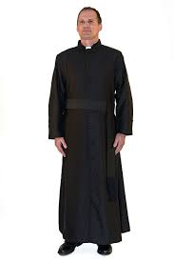
1. Black/red/white vestment worn by altar servers and priest.
Cassock

Slide 3
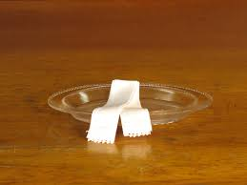
2. Small bowl for priest to wash hands during the liturgy of Eucharist
Finger Bowl

Slide 4
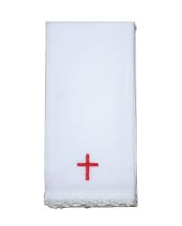
3. Small white cloth used with the chalice.
Purificator

Slide 5
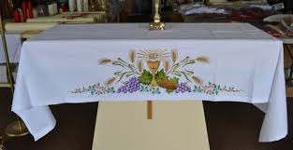
4. The tablecloth for the altar.
Altar Cloth

Slide 6
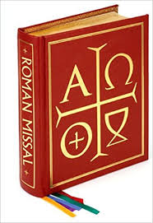
5. The book the priest prays from during the Mass at the altar.
Roman Missal

Slide 7
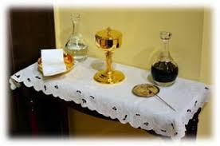
6. The small table off to one of the sanctuary for sacred vessels.
Credence Table

Slide 8
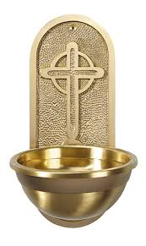
7. The holy water fountains or fonts at the entrances of the church.
Stoup

Slide 9
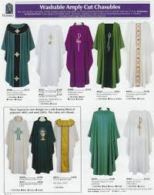
8. Special robes worn by priests, deacons, and altar servers.
Vestments

Slide 10
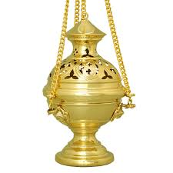
9. Container for burning incense.
Thurible

Slide 11
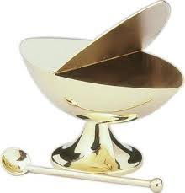
10. The container for incense.
Boat

Slide 12
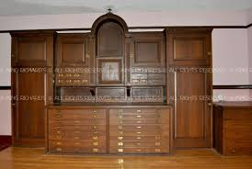
11. The room where priests vest before Mass.
Sacristy

Slide 13
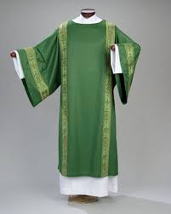
12. Colored vestment worn only by the deacon.
Dalmatic

Slide 14
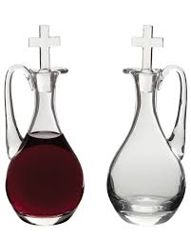
13. Small pitchers of water and wine for the Mass.
Cruets

Slide 15
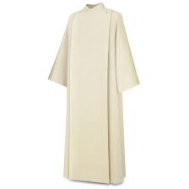
14. White robe worn over street clothes for priests, deacons & lay leaders
Alb

Slide 16
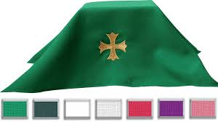
15. Cloth covering used to hide the chalice & paten up to the offertory and after Communion (of the liturgical color) .
Chalice Veil

Slide 17
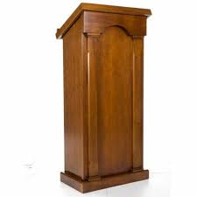
16. The place where the Word of God is proclaimed.
Ambo

Slide 18
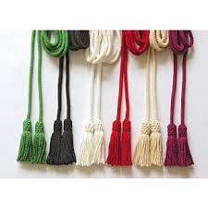
17. Cord used as a belt for the alb
Cincture

Slide 19
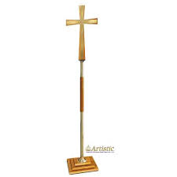
18. The cross carried in and out of the Mass.
Processional Cross

Slide 20
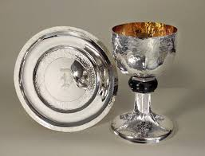
19. Small dish usually used with the chalice.
Patin

Slide 21
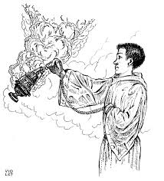
20. The server responsible for the Thurible.
Thurifer

Slide 22
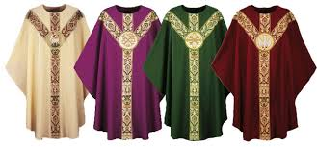
21. Colored vestment worn only by the priest.
Chasuble

Slide 23
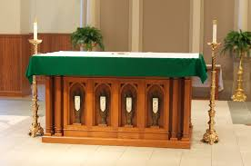
22. He table of the Lord in the sanctuary
Altar

Slide 24
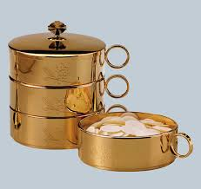
23. Gold cup with a lid for the Body of Christ in the Tabernacle.
Ciborium

Slide 25
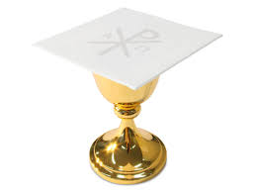
24. Stiff, white board placed over the chalice.
Pall

Slide 26
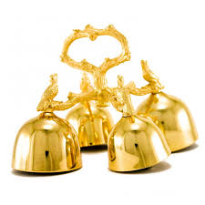
25. Rung during the Consecration of the Mass.
Bells

Slide 27
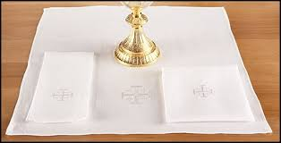
26. Small white cloth placed in the center of the Altar.
Corporal

Slide 28
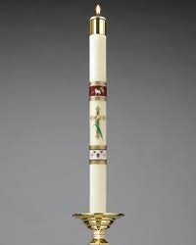
27. The large ornate candle used at funerals, baptisms, and Easter until Pentecost.
Pascal Candle

Slide 29
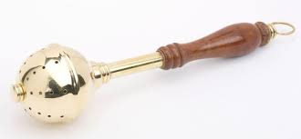
28. The holy water sprinkler.
Aspergillum

Slide 30
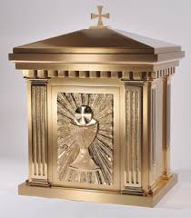
29. The ornate receptacle used to place the Body of Christ.
Tabernacle

Slide 31
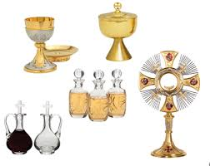
30. Sacred vessels used during the celebration of liturgy.
Altar Vessels

Slide 32
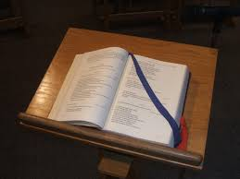
31. The book of scriptures read at the Liturgy of the Word.
Lectionary

Slide 33
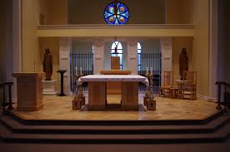
32. The sacred space elevated before the congregation.
Sanctuary

Slide 34
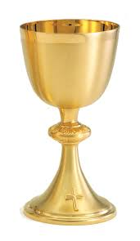
33. Gold cup used by the priest/Eucharistic ministers for the Blood of Christ.
Chalice

Slide 35
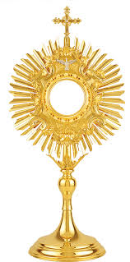
34. An open, transparent, often ornate receptacle in which the Consecrated Host is exposed for Adoration.
Monstrance

